Slide 1
Software in the scientific literature: Problems with seeing, finding, and using software mentioned in the biology literature.
James Howison and Julia Bullard
Information School
University of Texas at Austin
This material is based upon work supported by the National Science Foundation under Grant No. SMA-1064209.

Slide 2
Research Questions
How is software mentioned in papers?
What kinds of mentions are used?
How accessible and reusable is the software mentioned?
How do these mentions perform the functions of citation?
github.com/jameshowison/softcite
DOI: 10.6084/m9.figshare.1146366

Slide 3
Sample and Method
90 randomly selected articles from biology literature
Journals stratified across Journal Impact Factor to balance coverage with influence
Manual content analysis
developed reliable coding scheme across 3 coders, tested with Cohen’s Kappa

Slide 4
How many mentions?
59 articles mentioned software, 31 did not.
There were 286 distinct mentions of software.
Those mentions were to 146 distinct pieces of software.

Slide 5
Types of mentions
Mention Type | Example
Cite to Publication | … was calculated using biosys (Swofford & Selander 1981).
Cite to Project Name or Website | … using the program Autodecay version 4.0.29 PPC (Eriksson 1998). Reference List has: ERIKSSON, T. 1998. Autodecay, vers. 4.0.29 Stockholm: Department of Botany.
Like Instrument | … calculated by t-test using the Prism 3.0 software (GraphPad Software, San Diego, CA, USA).
URL in text | … freely available from http://www.cibiv.at/software/pda/ .
In-text name mention only | … were analyzed using MapQTL (4.0) software.
Not even name mentioned | … was carried out using software implemented in the Java programming language.

Slide 6
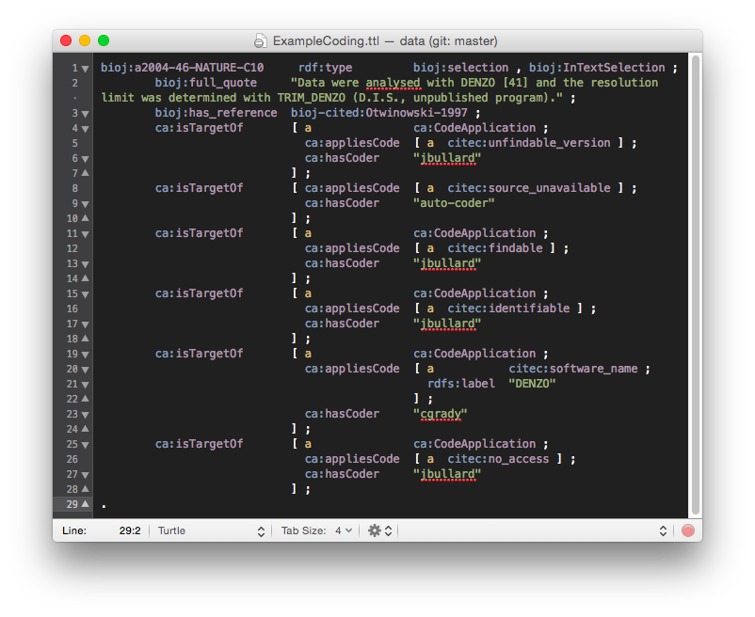
https://github.com/jameshowison/softcite/blob/master/data/software-citation-coding.ttl

Slide 7
Types of Mentions

Slide 8
Simpler Mention Kinds

Slide 9
By Strata?

Slide 10
What characteristics of software?

Slide 11
Simpler software types

Slide 12
Different software mentioned differently?

Slide 13
How useful are these mentions?

Slide 14
Not much change across strata

Slide 15
Do different mentions work?

Slide 16
Extras
Only 24% journals had policies that mentioned software, declining by strata.
Rarely mention versions.
Not clear that these are followed.
Only between 13–30% of packages make a specific request for citation
32% of mentions didn’t follow the citation.

Slide 17
Next steps
Use as “Gold Standard” dataset to train machine learning
Me with Yan Gao and Byron Wallace
You?
Broader studies in other fields
Assessing impact of policy changes
Use as validator on article submission
“It looks like you are trying to cite XYZ, please provide version and use this form”

